Slide 1
Chapter 7: Modeling System Requirements: Use Cases
One of the primary challenges is the ability to elicit the correct and necessary system requirements from the stakeholders and specify them in a manner understandable to them so those requirements can be verified and validated.
The hardest single part of building a software system is deciding precisely what to build. No other part of the conceptual work is a difficult as establishing the detailed technical requirements, including all the interfaces to people, to machines, and to other software systems. No other work so cripples the resulting system if done wrong. No other part is more difficult to rectify later. Fred Brooks
7-<number>
Notes:
Teaching Notes
This slide explains the industry problem that this material addresses.
If possible, the instructor should share real-life experiences in misunderstood or mis-specified system requirements.
To illustrate the inadequacy of data and process models, show the students some of the models from chapters 8 and 9. As them as novices if they can understand them.

Slide 2
User-Centered Development and Use-Case Modeling
User-centered development – a process of systems development based on understanding the needs of the stakeholders and the reasons why the system should be developed.
Use-case modeling – the process of modeling a system’s functions in terms of business events, who initiated the events, and how the system responds to those events.
  Use-case modeling has roots in object-oriented modeling.
  Gaining popularity in non-object development environments because of its usefulness in communicating with users.
  Compliments traditional modeling tools.
7-<number>
Notes:
Teaching Notes
There is nothing about user-centered development that requires use cases. But employing use cases in requirements analysis is an excellent way to make sure your project begins as user-centered development.

Slide 3
Benefits of Use-Case Modeling
Provides tool for capturing functional requirements.
Assists in decomposing system into manageable pieces.
Provides means of communicating with users/stakeholders concerning system functionality in language they understand.
Provides means of identifying, assigning, tracking, controlling, and managing system development activities.
Provides aid in estimating project scope, effort, and schedule.
7-<number>
Notes:
Teaching Notes
Using use-case modeling encourages user involvement.
By the same token, for use cases to be successful participation by the user is imperative.

Slide 4
Benefits of Use-Case Modeling (continued)
Aids in defining test plans and test cases.
Provides baseline for user documentation.
Provides tool for requirements traceability.
Provides starting point for identification of data objects or entities.
Provides specifications for designing user and system interfaces.
Provides means of defining database access requirements.
Provides framework for driving the system development project.
7-<number>
Notes:
Teaching Notes
Using use-case modeling encourages user involvement.
By the same token, for use cases to be successful participation by the user is imperative.

Slide 5
System Concepts for
Use-Case Modeling
Use case – a behaviorally related sequence of steps (scenario), both automated and manual, for the purpose of completing a single business task.
  Description of system functions from the perspective of external users in terminology they understand.
Use-case diagram – a diagram that depicts the interactions between the system and external systems and users.
  graphically describes who will use the system and in what ways the user expects to interact with the system.
Use-case narrative – a textual description of the business event and how the user will interact with the system to accomplish the task.
7-<number>
Notes:
Teaching Notes
use-case diagrams and use-case narratives are two views of the same sequence of steps that make up a conceptual use-case.
The use-case diagram communicates at a high level the scope of the business events that make up the Use-case.
The use-case narrative communicates at a more detailed level exactly how the user interacts with the system.
A use-case itself is not considered a functional requirement, but the use-case’s story, or scenario, consists of one or more requirements.

Slide 6
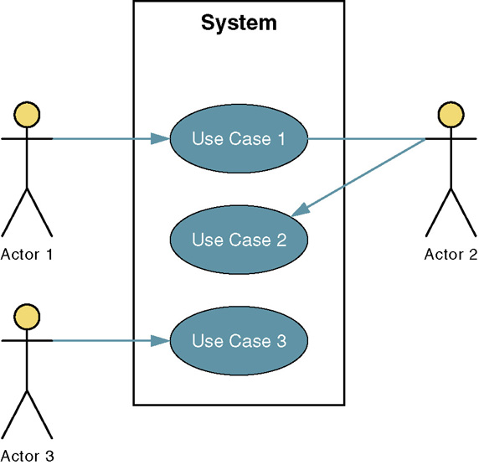
Sample Use-Case Model Diagram
7-<number>
Notes:
Teaching Notes
Definitions for these symbols are on the next slide.

Slide 7
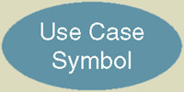
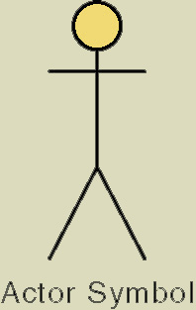
Basic Use-Case Symbols
Use case – subset of the overall system functionality
  Represented by a horizontal ellipse with name
  of use case above, below, or inside the ellipse.
Actor – anyone or anything that needs to interact with the system to exchange information.
  human, organization, another information system,
  external device, even time.
Temporal event – a system event triggered by time.
  The actor is time.
7-<number>
Notes:
Teaching Notes
Use cases are the results of deconstructing the scope of system functionality into many smaller statements of system functionality.
Use cases describe the system functions from the perspective of external users and in the manner and terminology in which they understand.
An actor initiates system activity, a use case, for the purpose of completing some business task. An actor represents a role fulfilled by a user interacting with the system and is not meant to portray a single individual or job title.
Have students provide examples of temporal events (nightly download, monthly billing, etc.).

Slide 8
Four Types of Actors
Primary business actor
  The stakeholder that primarily benefits from the execution of the use case.
  e.g. the employee receiving the paycheck
Primary system actor
  The stakeholder that directly interfaces with the system to initiate or trigger the business or system event.
  e.g. the bank teller entering deposit information
External server actor
  The stakeholder that responds to a request from the use case.
  e.g. the credit bureau authorizing a credit card charge
External receiver actor
  The stakeholder that is not the primary actor but receives something of value from the use case.
  e.g. the warehouse receiving a packing slip
7-<number>
Notes:
Teaching Notes
Walk students through a couple of real-life information systems, identifying actors. For instance, paying for groceries with a cashier would have:
Primary business actor - customer
Primary system actor - cashier
External server actor - if paying with a credit card, would be the credit card authorization company
External receiver actor - the distributor who receives data about purchases and inventory
If the customer was checking himself/herself out at a U-Scan terminal, then the customer would also be the primary system actor.

Slide 9
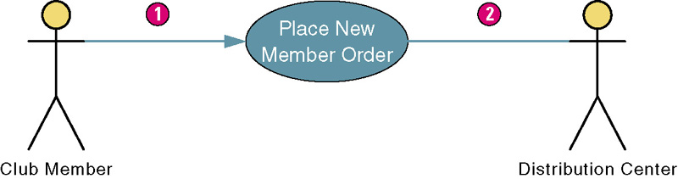
Use Case Association Relationship
Association – a relationship between an actor and a use case in which an interaction occurs between them.
  Association modeled as a solid line connecting the actor and the use case.
  Association with an arrowhead touching the use case indicates that the use case was initiated by the actor. (1)
  Association lacking arrowhead indicates a receiver actor. (2)
  Associations may be bidirectional or unidirectional.
7-<number>
Notes:
Teaching Notes
Most of the use case diagrams in this chapter shown only the primary system actor. This one also shows the external receiver actor. Use cases can be drawn to show some or all actors.

Slide 10
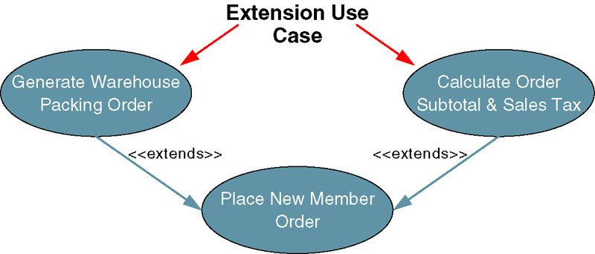
Use Case Extends Relationship
Extension use case –use case consisting of steps extracted from another use case to simplify the original.
  Extends the functionality of the original use case.
  Generally not identified in the requirements phase
  Extends relationship represented as arrow beginning at the extension use case and pointing to use case it is extending.
  Labeled <<extends>>.
7-<number>
Notes:
Teaching Notes
An extension use case is employed to simplify another use case. An extension use case may have an extends relationship to one or more other use cases.

Slide 11
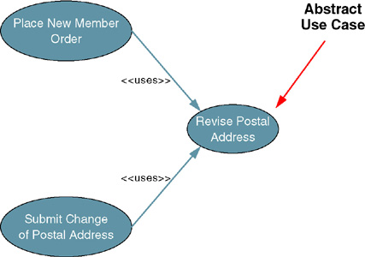
Use Case Uses Relationship
Abstract use case – use case that reduces redundancy in two or more other use cases by combining common steps found in both.
  Available by any other use case that requires its functionality.
  Generally not identified
  in requirements phase
  Relationship between
  abstract use case
  and use case that
  uses it is called a
  uses (or includes)
  relationship.
  Depicted as arrow
  beginning at
  original use case
  and pointing to
  use case it is using.
  Labeled <<uses>>.
7-<number>
Notes:
Teaching Notes
If your students have programming experience you can compare abstract use cases to programming code that is placed in public functions or classes. An abstract use case has a uses relationship to two or more other use cases.

Slide 12
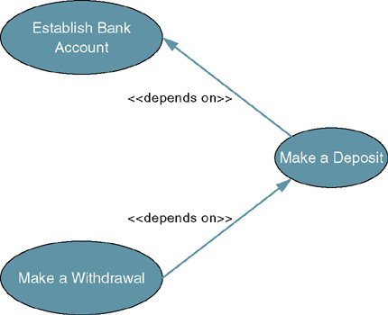
Use Case Depends On Relationship
Depends On – use case relationship that specifies which other use cases must be performed before the current use case.
  Can help determine
  sequence in which
  use cases need to
  be developed.
  Depicted as arrow
  beginning at one
  use case and
  pointing to use case
  it depends on.
  Labeled
  <<depends on>>.
7-<number>
Notes:
Teaching Notes
Identifying use case dependencies is discussed at the end of the chapter. It is useful when using build cycles to build the system in successive versions.

Slide 13
Use Case Inheritance Relationship
Inheritance – a use case relationship in which the common behavior of two actors initiating the same use case is extrapolated and assigned to a new abstract actor to reduce redundancy.
  Other actors can inherit the interactions of the abstract actor.
  Depicted as an arrow beginning at one
  actor and pointing to the abstract actor whose
  interactions the first actor inherits.
7-<number>
Notes:
Teaching Notes
Inheritance is depicted on the next slide.

Slide 14
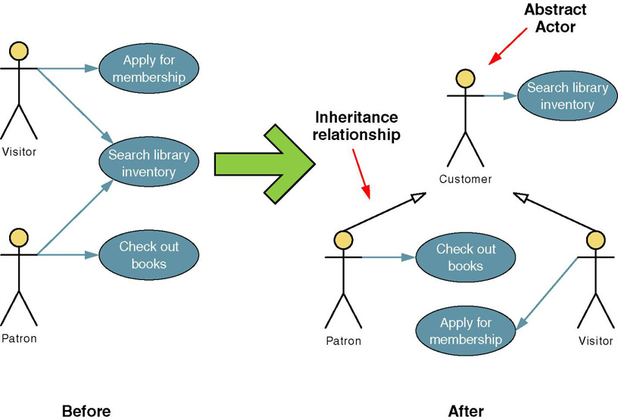
Use Case Inheritance Relationship
7-<number>
Notes:
Teaching Notes
Walk through the Before and After of this figure.
Students should understand that though we have added an actor, we have decreased the interactions we have to model.

Slide 15
The Process of Requirements
Use-Case Modeling
Objective is to elicit and analyze enough requirements information to prepare a model that:
  Communicates what is required from a user perspective.
  Is free of specific details about how system will be implemented.
To effectively estimate and schedule project, may need to include preliminary implementation assumptions.
Steps
  Identify business actors.
  Identify business use cases.
  Construct use-case model diagram.
  Documents business requirements use-case narratives.
7-<number>
Notes:
Teaching Notes
The individual steps will be discussed on the following slides.

Slide 16
Step 1: identify Business Actors
When looking for actors, ask the following questions:
  Who or what provides inputs to the system?
  Who or what receives outputs from the system?
  Are interfaces required to other systems?
  Are there events that are automatically triggered at a predetermined time?
  Who will maintain information in the system?
Actors should be named with a noun or noun phrase
7-<number>
Notes:
Teaching Notes
By focusing first on actors, you concentrate on how the the system will be used instead of how it will be built.
Focusing on actors helps refine and further define the scope and boundaries of the system.
Also, by first identifying actors you find candidates to interview and observe so you can develop and validate the use cases.

Slide 17
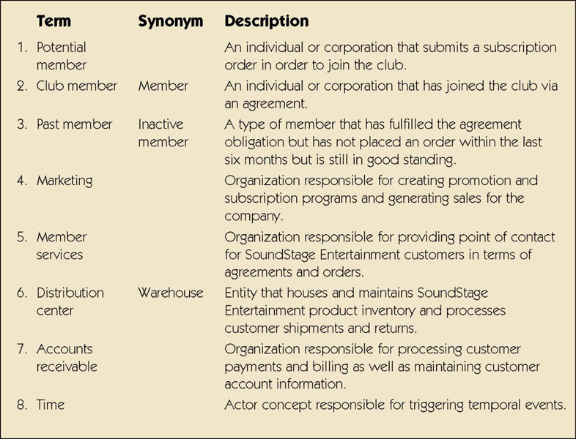
Sample List of Actors
7-<number>
Notes:
Teaching Notes
The can be called an actor glossary.

Slide 18
Step 2: Identify Business Requirements Use Cases
Business Requirements Use Case - a use case created during requirements analysis to capture the interactions between a user and the system free of technology and implementation details.
  During requirements analysis, strive to identify and document only the most critical, complex, and important use cases, often called essential use cases.
7-<number>
Notes:
No additional notes.

Slide 19
Step 2: Identify Business Requirements Use Cases (cont.)
When looking for use cases, ask the following questions:
  What are the main tasks of the actor?
  What information does the actor need from the system?
  What information does the actor provide to the system?
  Does the system need to inform the actor of any changes or events that have occurred?
  Does the actor need to inform the system of any changes or events that have occurred?
Use cases should be named with a verb phrase specifying the goal of the actor (i.e. Submit Subscription Order)
7-<number>
Notes:
No additional notes.

Slide 20
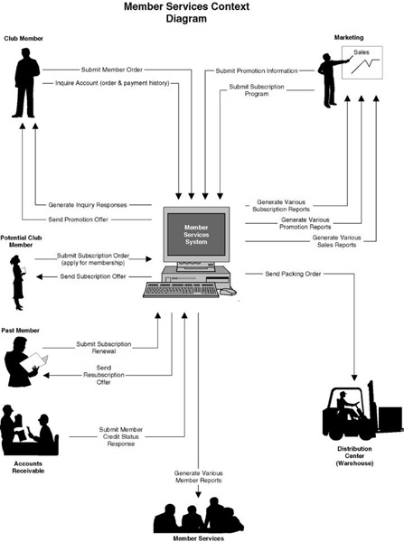
Sample Context Diagram
7-<number>
Notes:
Conversion Notes
In the seventh edition we introduced context diagrams in chapter 5, so this may be review.
Teaching Notes
A context diagram is an excellent source for analyzing actors and finding potential use cases.
The primary inputs that trigger business events are considered use cases, and the external parties that provide those inputs are considered actors.
Individual reports are often not listed on a context diagram to reduce clutter. The systems analyst must research with the appropriate stakeholders the outputs they receive to uncover these "hidden use cases."
This is a different format than the context diagram used in chapter 5 or the context DFD from chapter 9, but the concepts are the same.

Slide 21
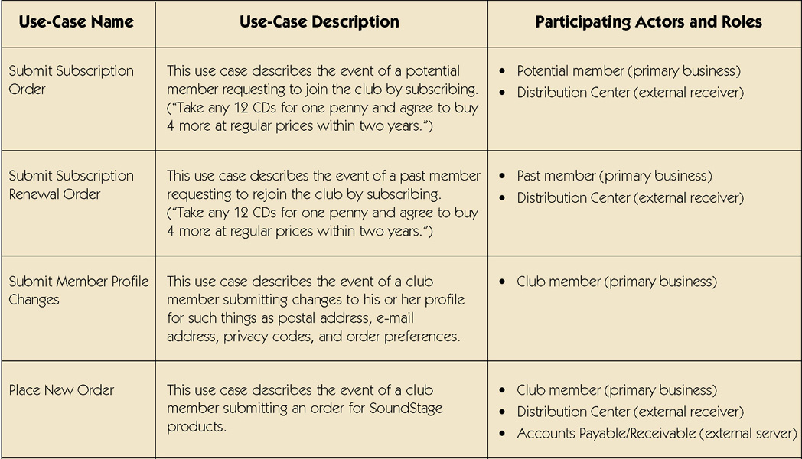
Sample Use-Case Glossary
7-<number>
continued
Notes:
No additional notes

Slide 22
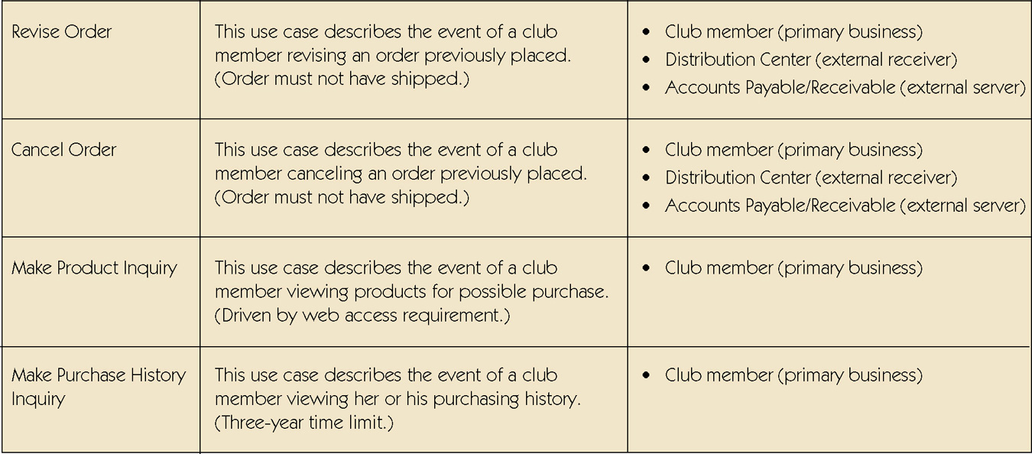
Sample Use-Case Glossary (cont.)
7-<number>
continued
Notes:
No additional notes

Slide 23
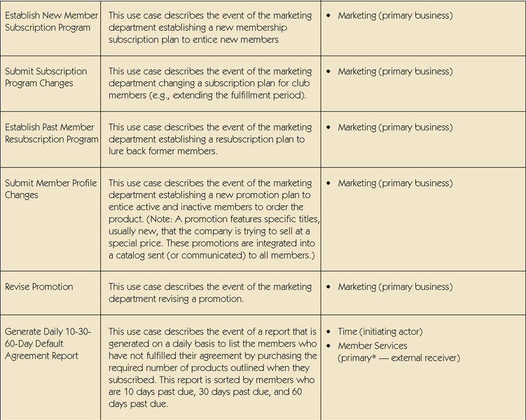
Sample Use-Case Glossary (cont.)
7-<number>
Notes:
No additional notes

Slide 24
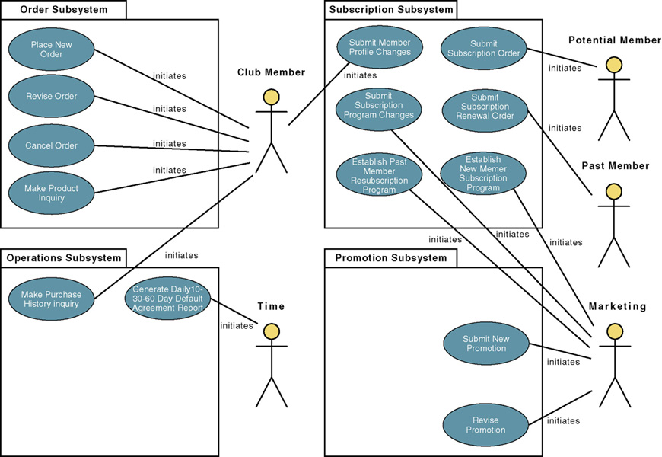
Step 3: Construct Use-Case Model Diagram
7-<number>
Notes:
Teaching Notes
Note that the use cases have been grouped into business sub-systems. This is key to defining your development strategy – which use cases will be developed first and by whom.

Slide 25
Step 4: Document Business Requirements Use-Case Narratives
Document first at high level to quickly obtain an understanding of the events and magnitude of the system.
Then expand to a fully-documented business requirement narrative.
  Include the use case’s typical course of events and its alternate courses.
7-<number>
Notes:
No additional notes.

Slide 26
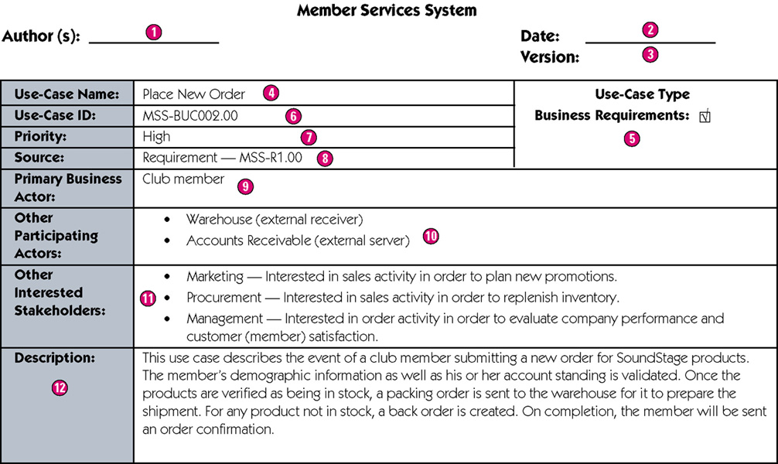
Sample High-Level Use-Case Narrative
7-<number>
Notes:
Teaching Notes
Author – the persons who wrote the use case and provide a point of contact for anyone requiring additional information.
Date – the date the use case was last modified.
Version – the current version of the use case.
Use-case name – the use-case name should represent the goal that the use case is trying to accomplish. Should begin with a verb.
Use-case type – Business requirements use cases provide a general understanding of the problem domain and scope but don’t include detail to communicate to developers what the system should do.
Use-case ID – A unique identifier for the use case.
Priority – The priority communicates the importance of the use case (high, medium, or low).
Source – The source defines the entity that triggered the creation of the use case.
Primary business actor – The stakeholder that primarily benefits from the execution of the use case.
Other participating actors – Other actors that participate in the use case.
Interested stakeholders – A person (other than the actor) who has a vested interest in the goal of the use case.
Description – A short summary description of the purpose of the use case and its activities.

Slide 27
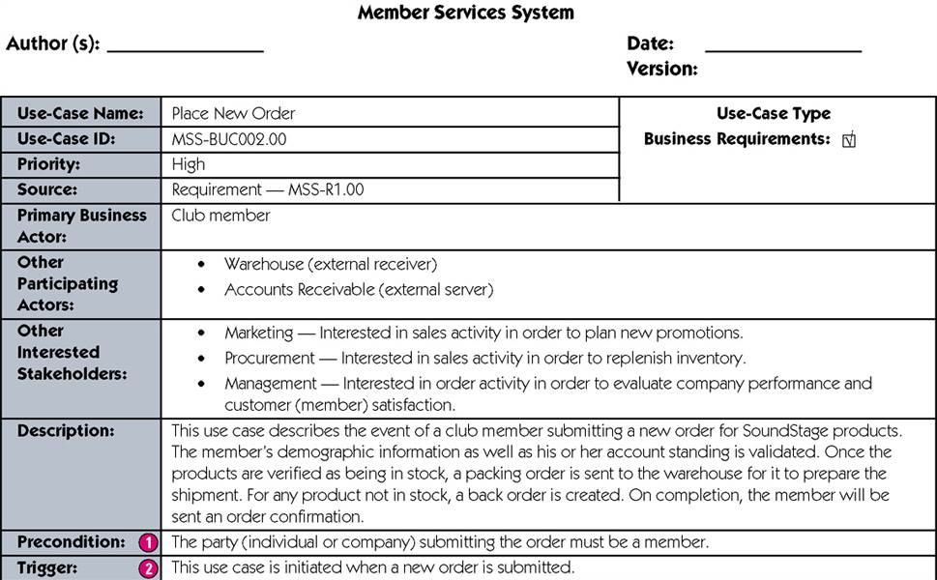
Sample Expanded Use-Case Narrative
7-<number>
continued
Notes:
Teaching Notes
Precondition – A constraint on the state of the system before the use case can be executed.
Trigger – The event that initiates the use case.

Slide 28
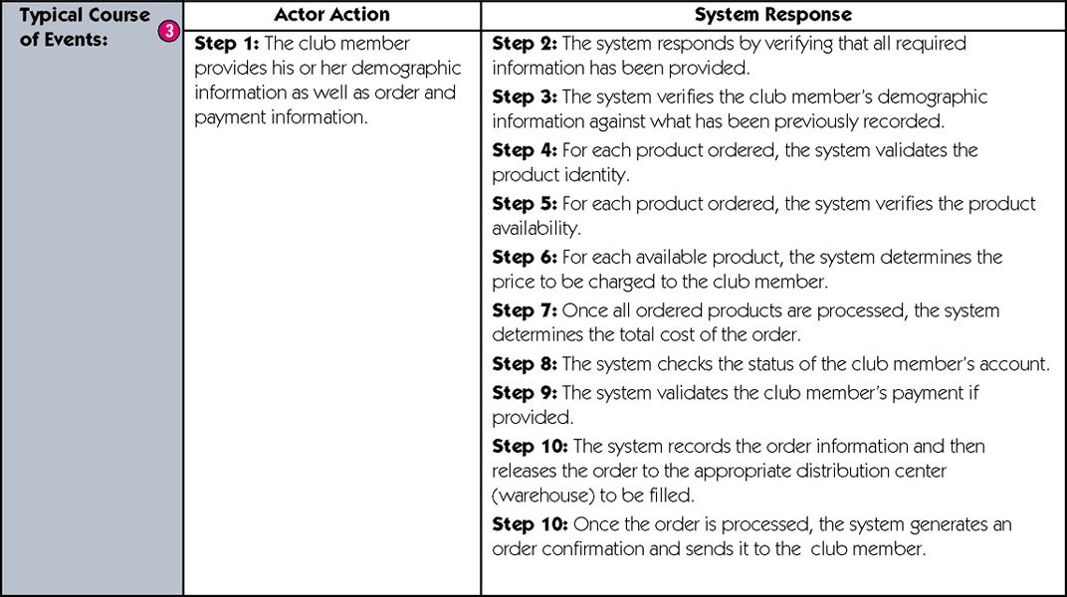
Expanded Use-Case Narrative (cont)
7-<number>
continued
Notes:
Teaching Notes
Typical course of events – The normal sequence of activities performed by the actor(s) and the system to satisfy the goal of the use case.

Slide 29
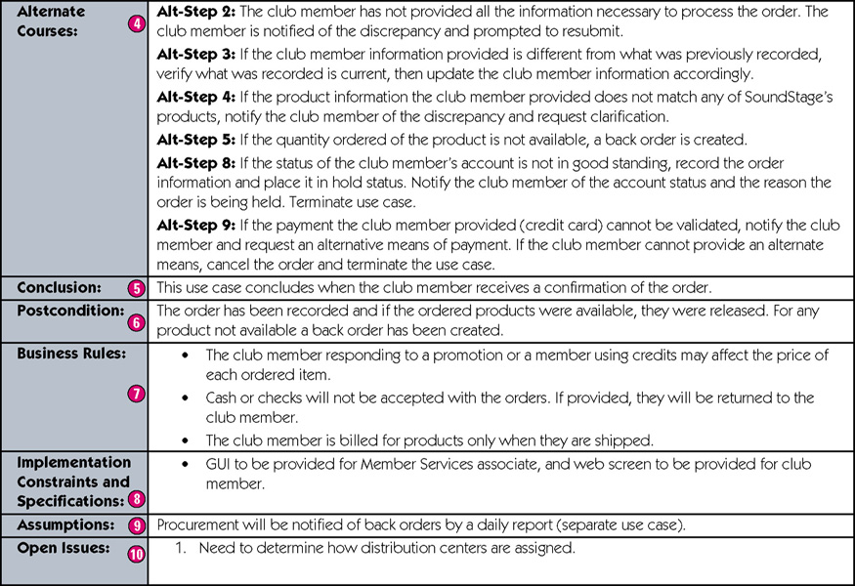
Expanded Use-Case Narrative (cont)
7-<number>
Notes:
Teaching Notes
Alternate courses – The behaviors of the use case if an exception or variation to the typical course occurs.
Conclusion – When the use case successfully ends.
Postcondition – A constraint on the state of the system after the use case has successfully executed.
Business rules – Policies and procedures of the business that the system must abide by.
Implementation constraints and specifications – Any nonfunctional requirements that may impact the realization of the use case.
Assumptions – Assumptions made by the author.
Open issues – Issues that need to be resolved before the use case can be finalized.

Slide 30
Use Cases and Project Management
Use-case model can drive entire development effort.
Project manager or systems analyst uses business requirements use cases to estimate and schedule the build cycles of the project.
  Build cycles are scoped on the basis of the importance of the use case and the time it takes to implement the use case.
To determine importance of use cases, will create:
  Use-case ranking and evaluation matrix
  Use-case dependency diagram
7-<number>
Notes:
Teaching Notes
You can relate this to the concept of timeboxing discussed in chapter 5.

Slide 31
Use-Case Ranking and Priority Matrix
In most projects, the most important use cases are developed first.
  Use-case ranking and priority matrix – a tool used to evaluate use cases and determine their priority.
  Evaluates use cases on 1-5 scale against six criteria.
    Significant impact on the architectural design.
    Easy to implement but contains significant functionality.
    Includes risky, time-critical, or complex functions.
    Involves significant research or new or risky technology.
    Includes primary business functions.
    Will increase revenue or decrease costs.
7-<number>
Notes:
Teaching Notes
A sample matrix is shown on the next slide.

Slide 32
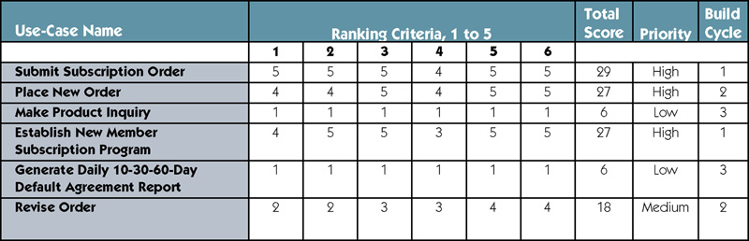
Sample Use-Case Ranking and Priority Matrix
7-<number>
Notes:
Teaching Notes
The ranking criteria are explained on the previous slide.

Slide 33
Use-Case Dependency Diagram
Use-case dependency diagram – graphical depiction of the dependencies among use cases.
  Provides the following benefits:
    Graphical depiction of the system’s events and their states enhances understanding of system functionality.
    Helps identify missing use cases.
    Helps facilitate project management by depicting which use cases are more critical.
7-<number>
Notes:
Teaching Notes
A sample dependency diagram is shown on the next slide.

Slide 34
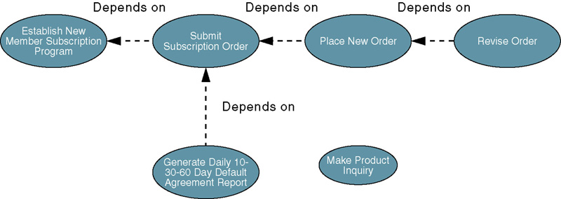
Sample Use-Case
Dependency Diagram
7-<number>
Notes:
No additional notes.

